Slide 1


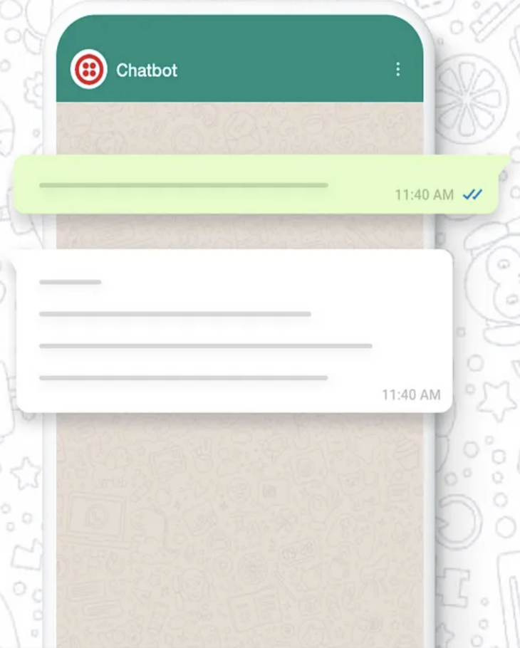






Integrated CHAT
GPT with
WhatsApp

Slide 2






request/response
OpenAI API key
Send Message
Receive Message
request/response
Twilio Phone Number: +14155238886
WhatsApp number: +XXXXXXXXXX
request
response
request/response
https://a94a-59-188-152-97.ngrok-free.app/sms
WhatsApp – CHAT GPT - Architecture

